Slide 1
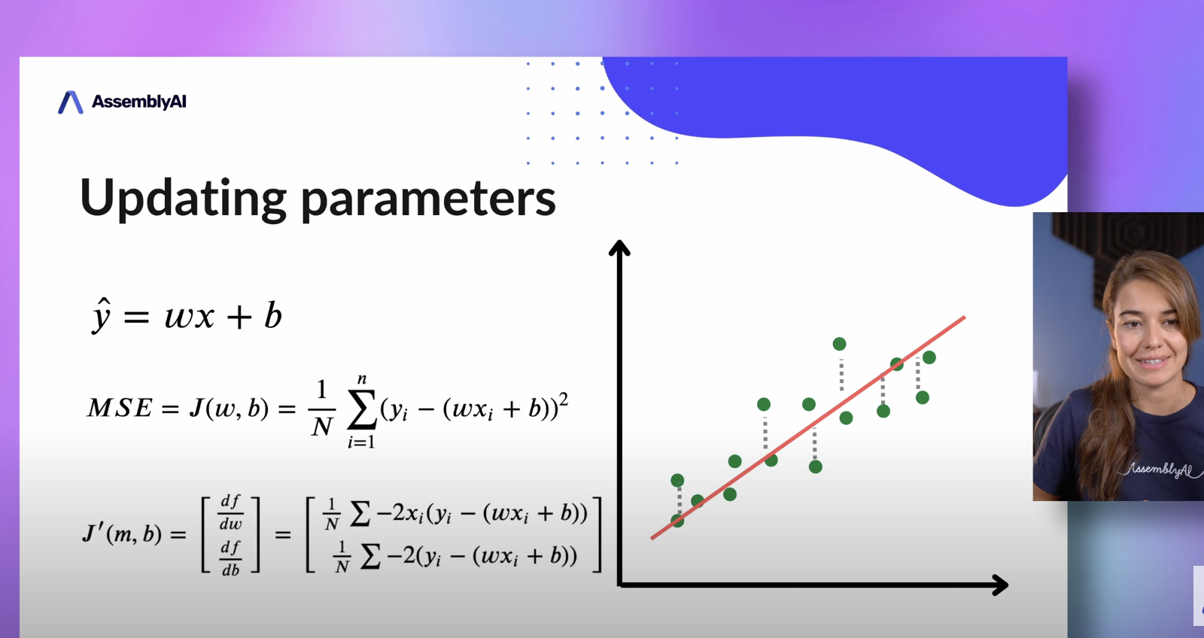
Notes:
Equations:
1. Linear Regression.
2. Cost/Loss Function.
3. Optimizer – Gradient Descent.
https://www.youtube.com/watch?v=ltXSoduiVwY&ab_channel=AssemblyAI

Slide 2
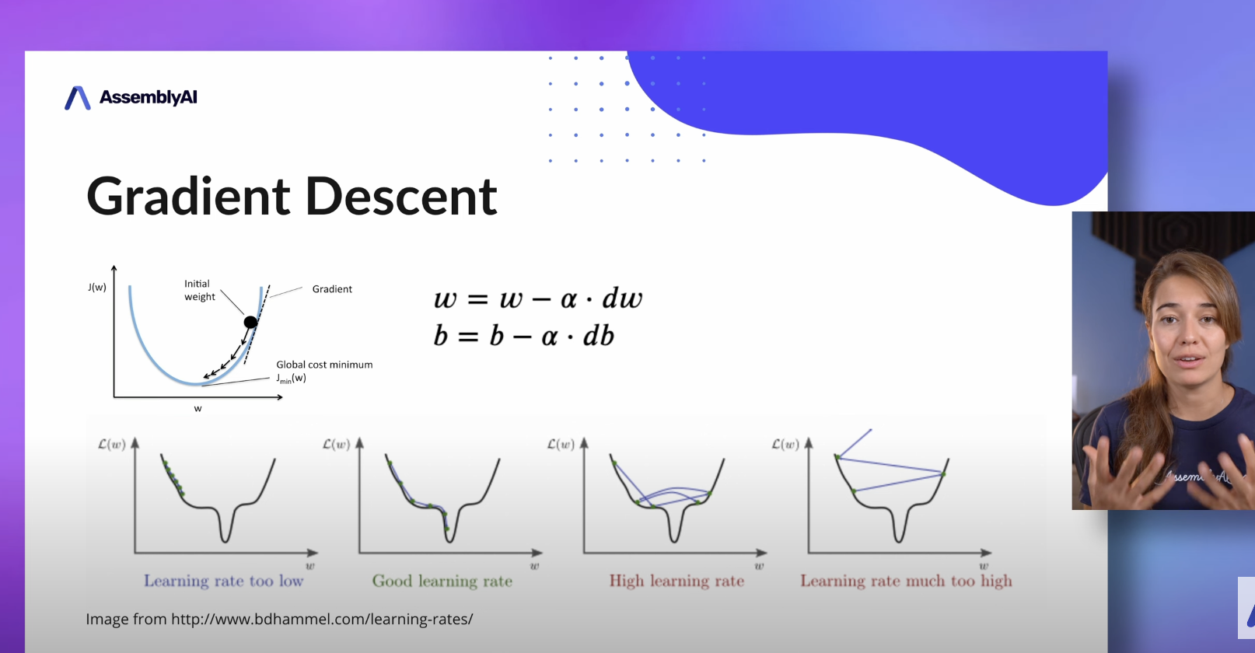

Slide 3
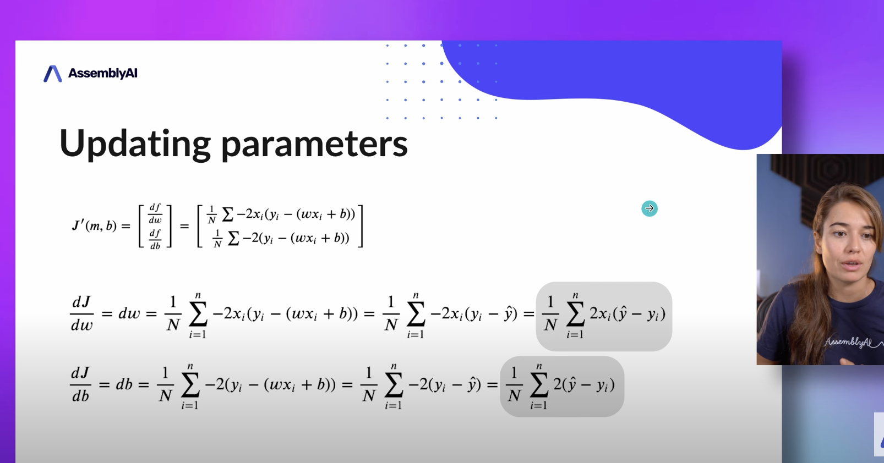
Notes:
dJ/dW optimizer is easier to implement , so we will use that.

Slide 4
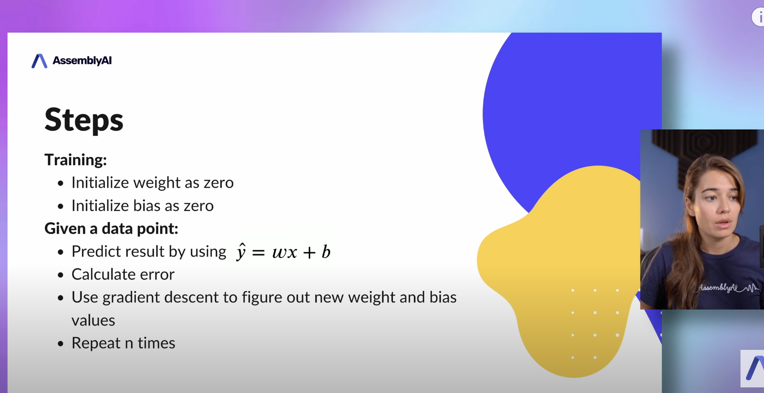

Slide 5
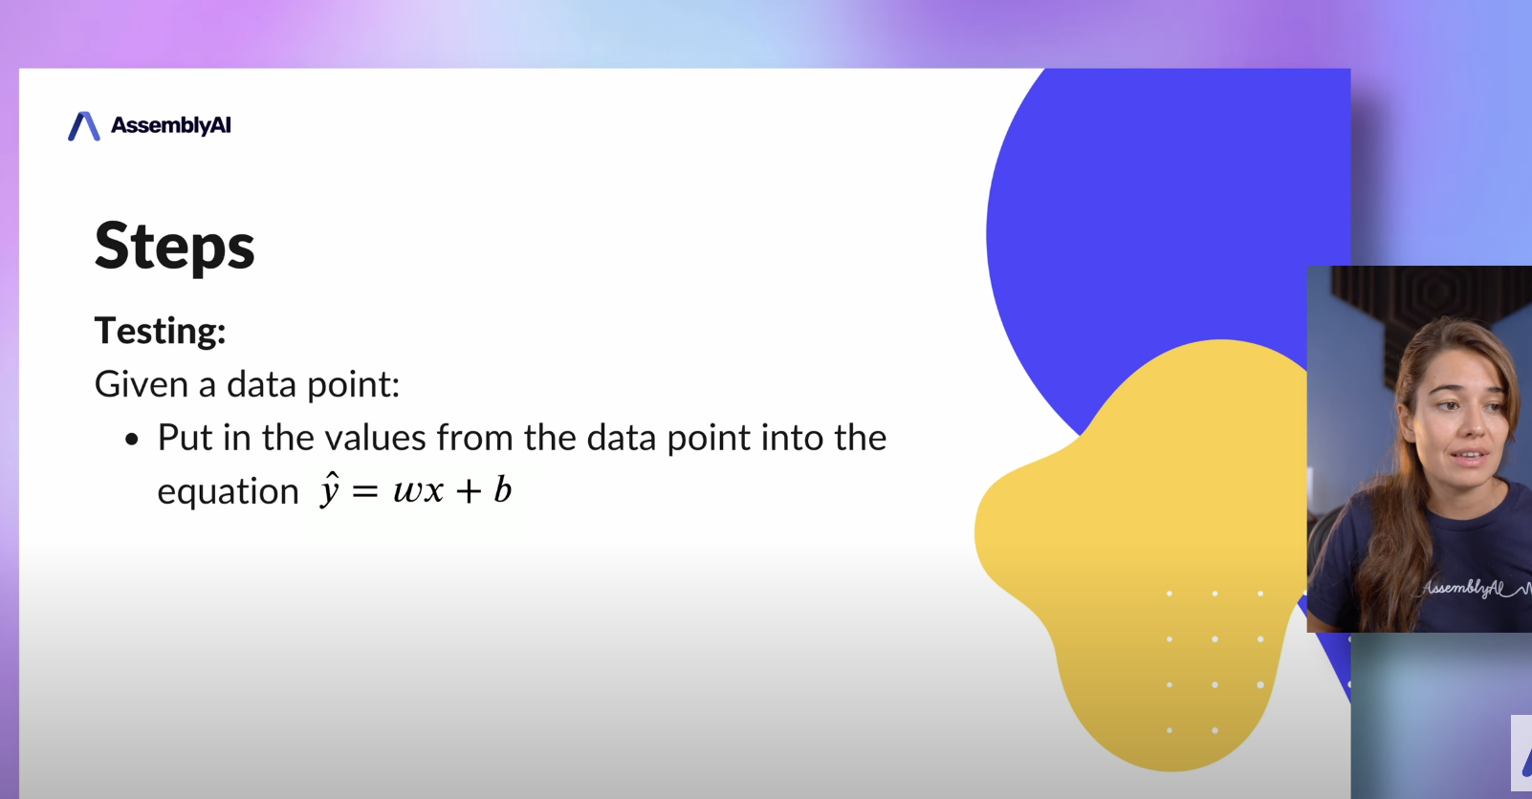

Slide 6
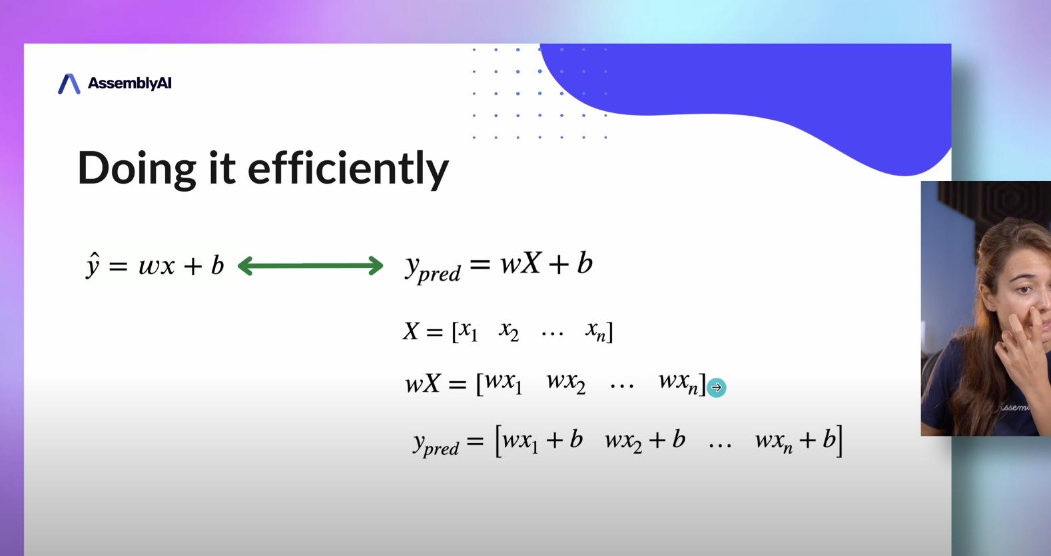

Slide 7
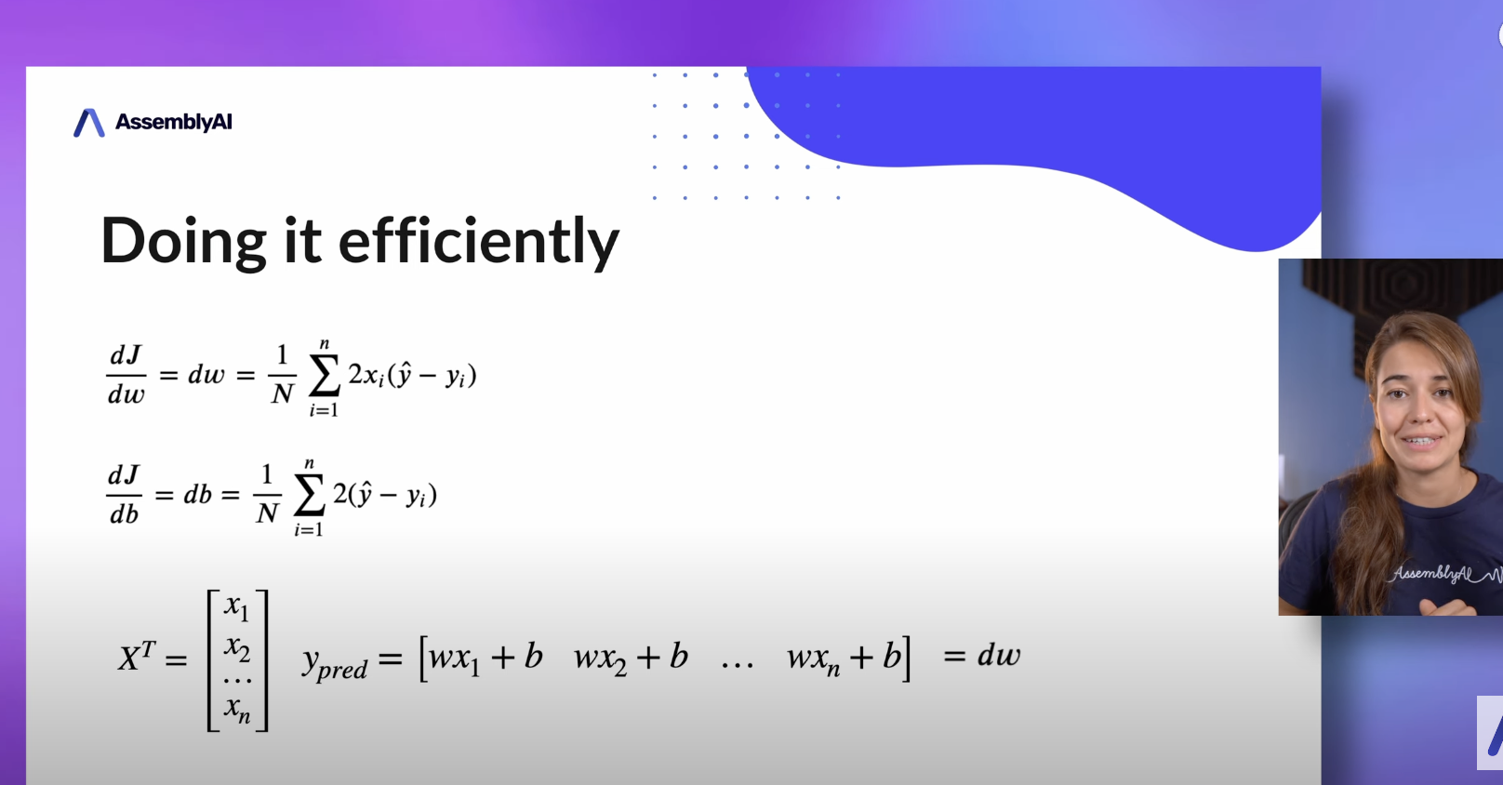
Notes:
We usually take the features in X and create a transpose of it. It is easier like this to perform matrix multiplication.

Slide 8
Linear Regression Code
Class LR:
Constructor:
Learning Rate
No of iterations
Bias
Weights
Fit Function(X, y)
Predict Function(X)

